Slide 1
PIDdling
Building and Tuning a Stable, Responsive Control Loop

Slide 2

Aside -- Why Electric Drive?

Slide 3
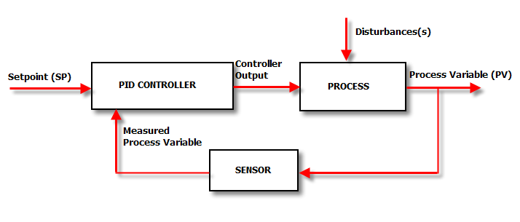
Basic Control Loop
What is out setpoint? Disturbances?
What is our process variable?

Slide 4
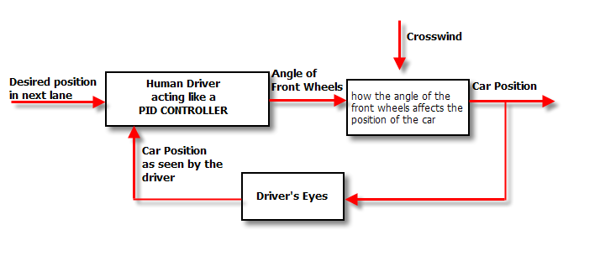
Automotive Example
Getting warmer ...

Slide 5
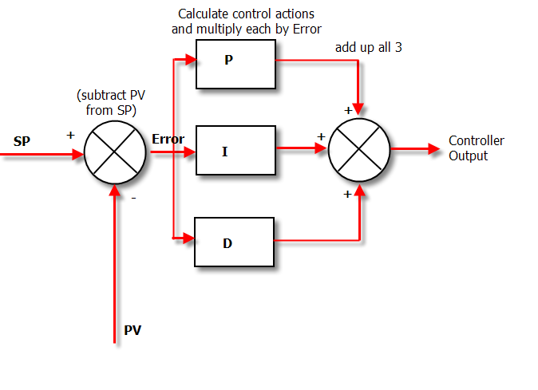
The Brain

Slide 6
PID Usage
Common combinations:
P – Sometimes used
PI - Most often used
PID – Sometimes used
PD – rare but can be useful for controlling servomotors.

Slide 7
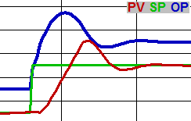
SPOPPV
SetPoint, (Controller) OutPut, ProcessVariable

Slide 8
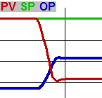
Proportional Gain
How much change OP will make due to a change in error (from ΔPV and/or ΔSP)

Slide 9
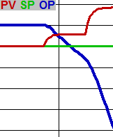
Integral Gain
How much to change OP over time due to error.

Slide 10
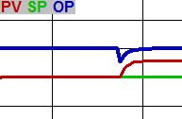
Preact
Derivative Gain = how much to change OP due to a change in DIRECTION of error.

